Slide 1


Kafka
From zero to hero
… somewhat. At least enough to get started
Emil H. Clausen <emcla@dfds.com>
Tobias Andersen <toban@dfds.com>
Find presentation at: seq.tf/r/kafka-presentation

Slide 2
Kafka
From zero to hero
… somewhat. At least enough to get started
Emil H. Clausen <emcla@dfds.com>
Touches just enough to get started
Does not cover everything Kafka
Find presentation at: seq.tf/r/kafka-presentation

Slide 3
What is it?
Where do I use it?
How?
A baseline schema format
Basic implementation of consuming and producing
Emil H. Clausen <emcla@dfds.com>

Slide 4
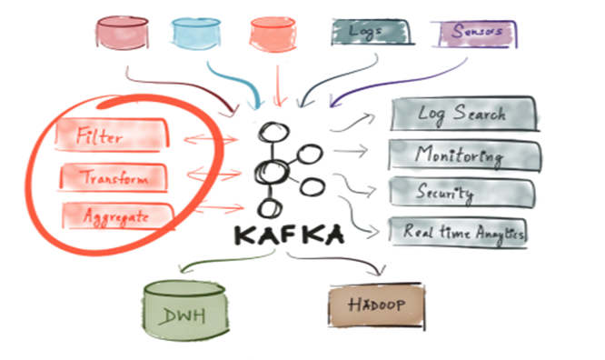
What is it?
Streaming platform
PUB/SUB -> Produce/Consume (in Kafka terms)
… A bunch more that isn’t covered by this workshop
Emil H. Clausen <emcla@dfds.com>
Tobias Andersen <toban@dfds.com>

Slide 5
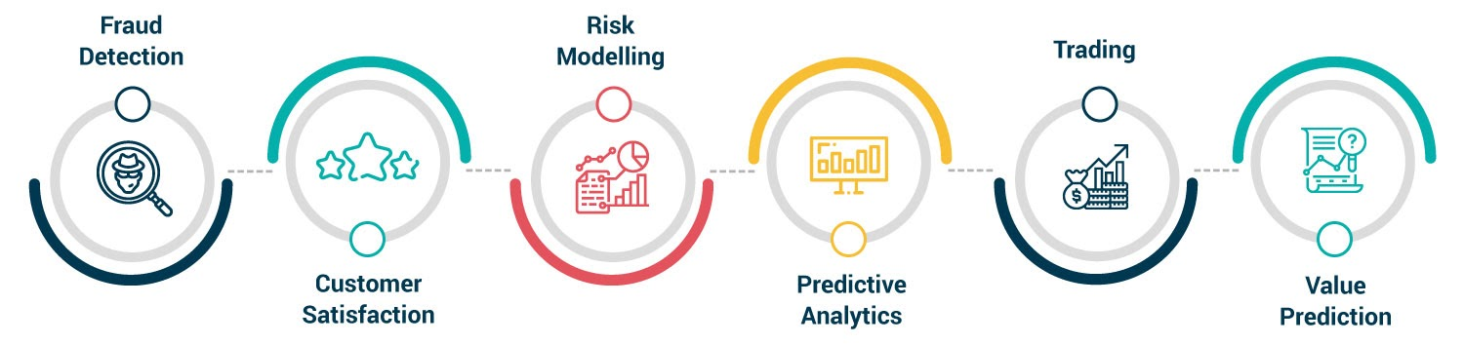
Use cases
Tobias Andersen <toban@dfds.com>

Slide 6
For what and where
Any applications where
1 or more other applications would be interested in a change of state
Useful data is generated that other teams may wanna use (e.g. ‘Ship has been loaded with parcels’, ‘Order has been processed’)
Emil H. Clausen <emcla@dfds.com>

Slide 7
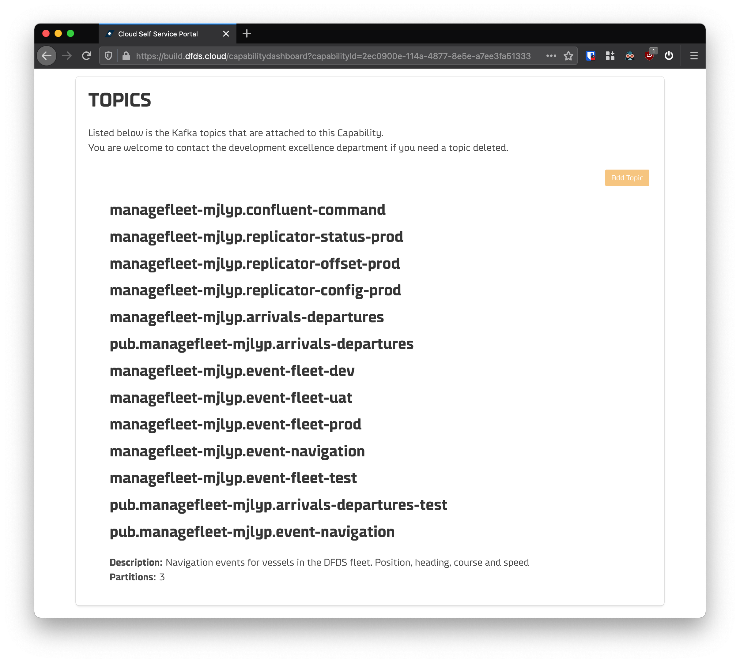
For what and where
Emil H. Clausen <emcla@dfds.com>

Slide 8
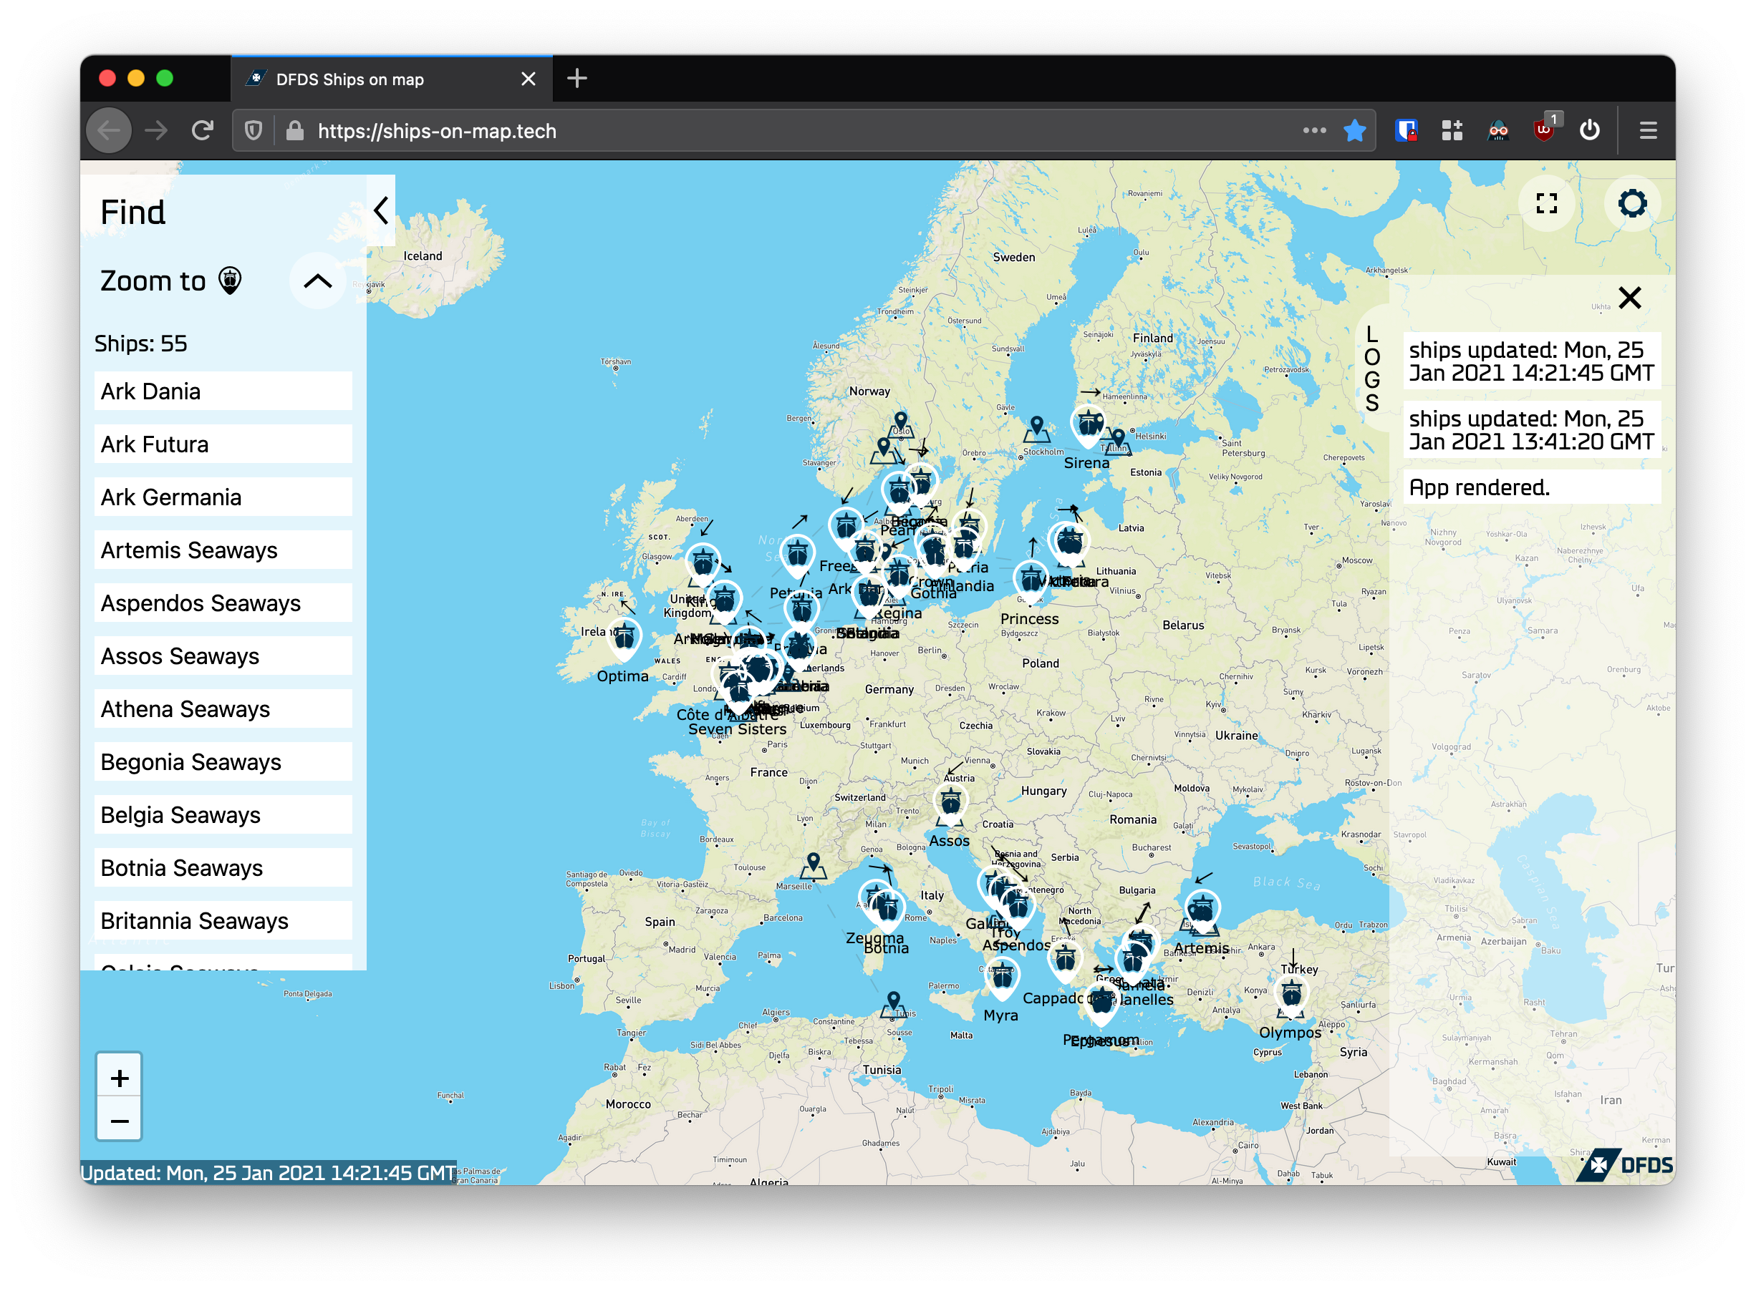
For what and where
Emil H. Clausen <emcla@dfds.com>

Slide 9
How?
Consumer #1
Topic
Producer
Consumer #2
Emil H. Clausen <emcla@dfds.com>

Slide 10
How?
Topic
A stream of data
Emil H. Clausen <emcla@dfds.com>

Slide 11
How?
Topic
Producer
Something that publishes messages to a Topic
Emil H. Clausen <emcla@dfds.com>

Slide 12
How?
Consumer #1
Topic
Producer
Consumer #2
Something that receives all messages sent to an attached Topic
Emil H. Clausen <emcla@dfds.com>

Slide 13
How?
Consumer #1
CG: Harald
Topic
Producer
Consumer #2
CG: Blaster
CG: “Consumer group”
Used for differentiating consumers
Emil H. Clausen <emcla@dfds.com>

Slide 14
How?
Consumer #1
CG: Harald
Topic
Producer
Consumer #2
CG: Blaster
Because the CG is unique, both consumers receive the event
Emil H. Clausen <emcla@dfds.com>

Slide 15
How?
Consumer #1
CG: Harald
Topic
Producer
Consumer #2
CG: Harald
Because both consumers share the same CG, only one of them receives the event
Emil H. Clausen <emcla@dfds.com>

Slide 16
How?
Consumer #1
CG: Harald
Topic
Producer
Consumer #2
CG: Harald
Because both consumers share the same CG, only one of them receives the event
Emil H. Clausen <emcla@dfds.com>

Slide 17
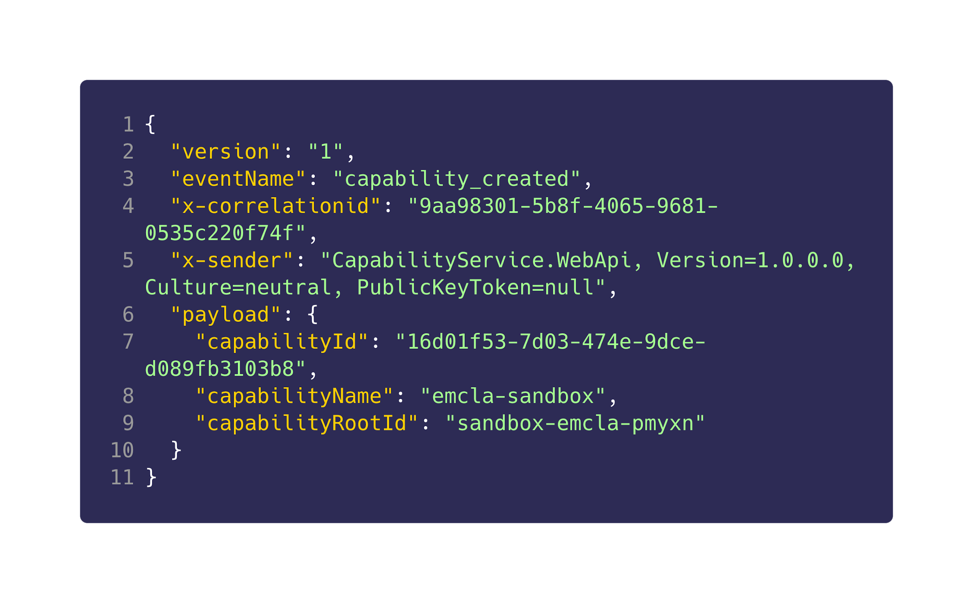
Schema format
Emil H. Clausen <emcla@dfds.com>

Slide 18
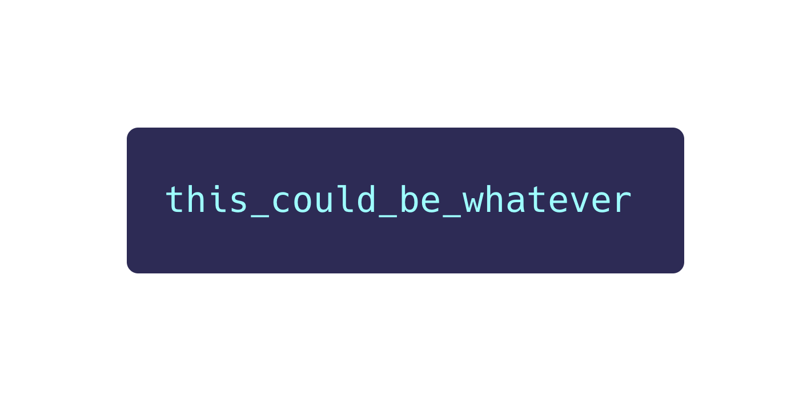
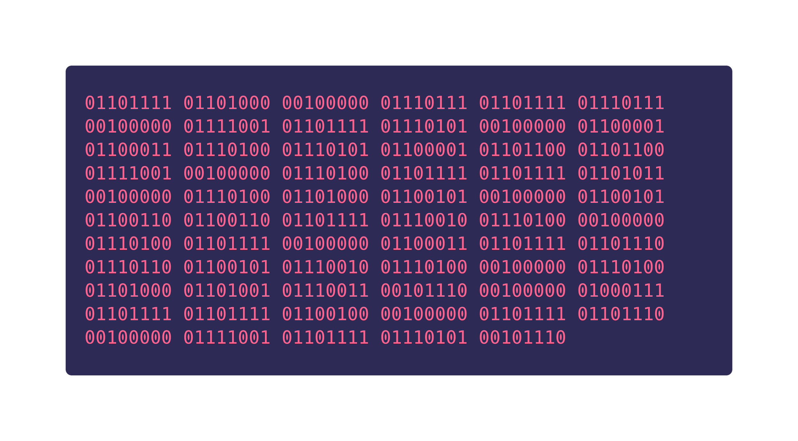
Schema format
Emil H. Clausen <emcla@dfds.com>

Slide 19
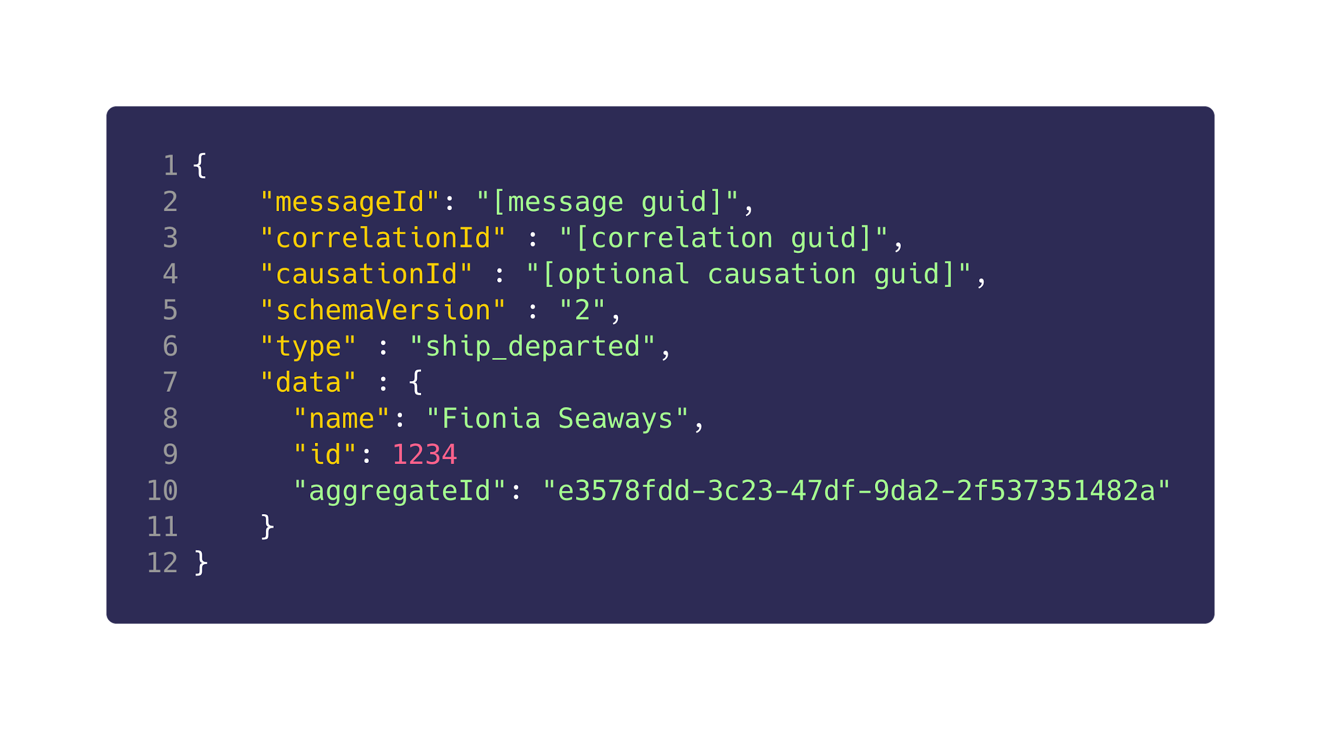
Schema format
for public topics
Find full guidelines at: seq.tf/r/kafka-public
Emil H. Clausen <emcla@dfds.com>

Slide 20
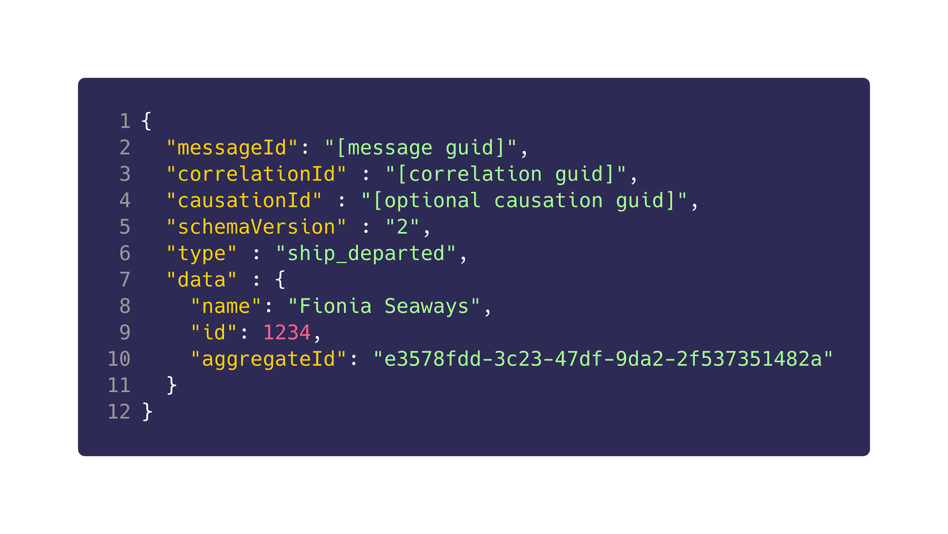
Schema format
custom
public
Emil H. Clausen <emcla@dfds.com>

Slide 21
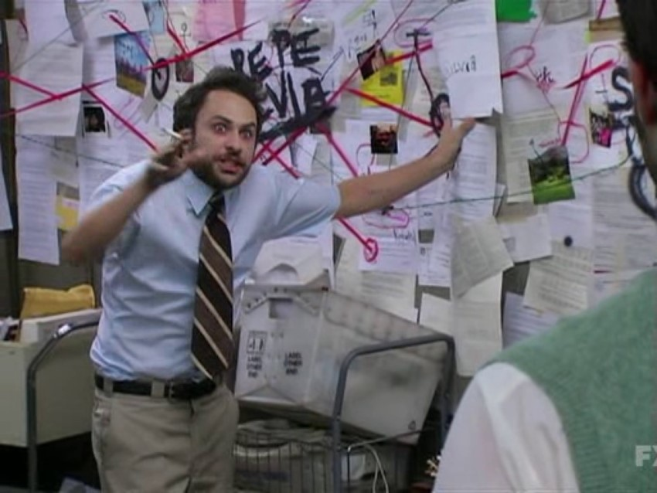
Schema format
custom
public
Emil H. Clausen <emcla@dfds.com>

Slide 22
Schema format
custom
public
Emil H. Clausen <emcla@dfds.com>

Slide 23
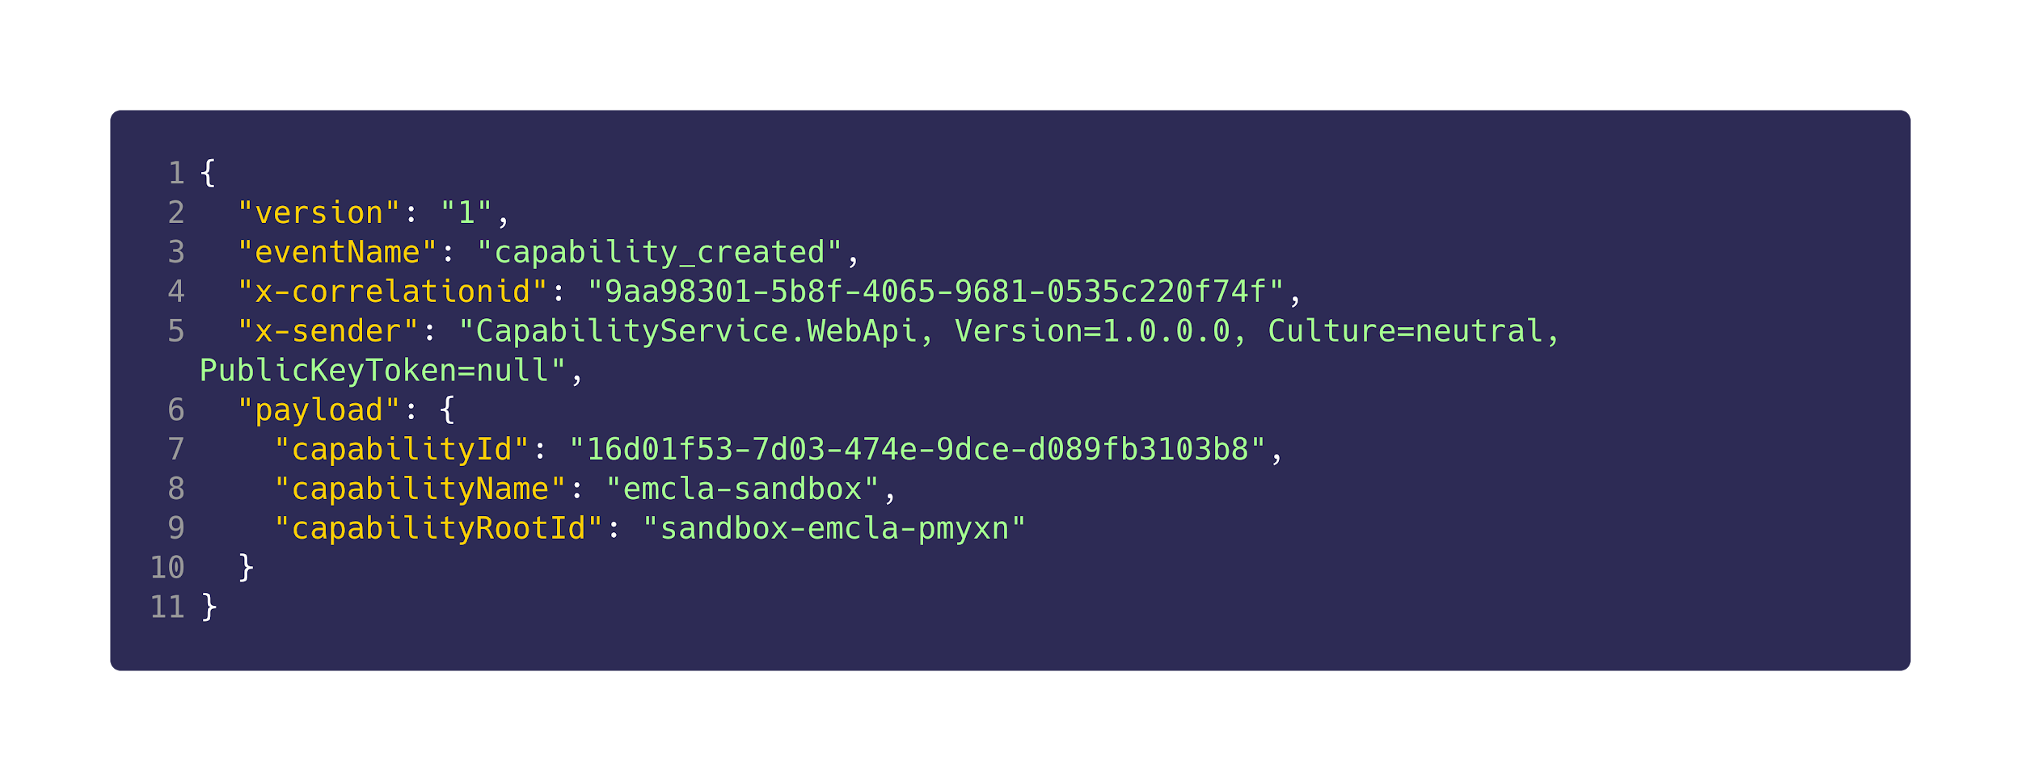
Schema format
In case of schema format update
Emil H. Clausen <emcla@dfds.com>

Slide 24
Schema format
Used for identifying and handling of an Event
Naming examples:
member_joined_capability
topic_added
capability_updated
Emil H. Clausen <emcla@dfds.com>

Slide 25
Schema format
Keeping track of an Event throughout your entire system
Emil H. Clausen <emcla@dfds.com>

Slide 26
Schema format
See where Event originated
Emil H. Clausen <emcla@dfds.com>

Slide 27
Schema format
Your Event specific
data / metadata
Emil H. Clausen <emcla@dfds.com>

Slide 28
Q&A
Before kata
Emil H. Clausen <emcla@dfds.com>
Tobias Andersen <toban@dfds.com>

Slide 29
Basic implementation
of consuming and producing
Presentation: seq.tf/r/kafka-presentation
Learning material: seq.tf/r/kafka-kata
Public event guidelines: seq.tf/r/kafka-public
Emil H. Clausen <emcla@dfds.com>
Tobias Andersen <toban@dfds.com>

Slide 30

Kata #1
Est: 15 Mins
or until everyone has completed it
Presentation: seq.tf/r/kafka-presentation
Learning material: seq.tf/r/kafka-kata
Public event guidelines: seq.tf/r/kafka-public
Emil H. Clausen <emcla@dfds.com>
Tobias Andersen <toban@dfds.com>

Slide 31
Kata #2
Est: 30 Mins
or until everyone has completed it
Presentation: seq.tf/r/kafka-presentation
Learning material: seq.tf/r/kafka-kata
Public event guidelines: seq.tf/r/kafka-public
Emil H. Clausen <emcla@dfds.com>
Tobias Andersen <toban@dfds.com>

Slide 32
Kata #3
Est: 10 Mins
or until everyone has completed it
Presentation: seq.tf/r/kafka-presentation
Learning material: seq.tf/r/kafka-kata
Public event guidelines: seq.tf/r/kafka-public
Emil H. Clausen <emcla@dfds.com>
Tobias Andersen <toban@dfds.com>

Slide 33
Kata #4
Est: 15 Mins
or until everyone has completed it
Presentation: seq.tf/r/kafka-presentation
Learning material: seq.tf/r/kafka-kata
Public event guidelines: seq.tf/r/kafka-public
Emil H. Clausen <emcla@dfds.com>
Tobias Andersen <toban@dfds.com>

Slide 34
Feedback
seq.tf/r/kafka-feedback
Emil H. Clausen <emcla@dfds.com>
Tobias Andersen <toban@dfds.com>

